Slide 1
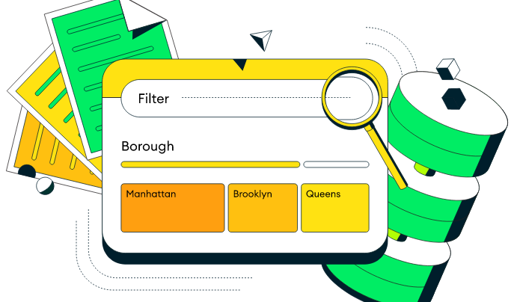
MongoDB CRUD
Create Operations
Read Operations
Update Operations
Delete Operations

Slide 2
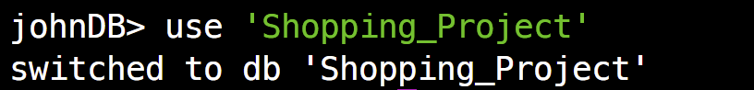
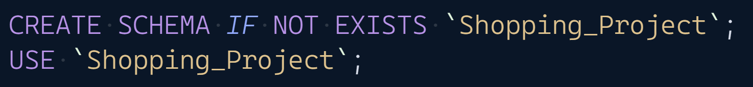
Create And Use database
If a database does not exist, MongoDB creates the database when you first store data for that database
List database
MongoDB
SQL
MongoDB
SQL

Slide 3

Create a Collection (Table)
If the collection does not currently exist, insert operations will create the collection.
List collections
MongoDB | Don not need.
SQL
MongoDB
SQL

Slide 4
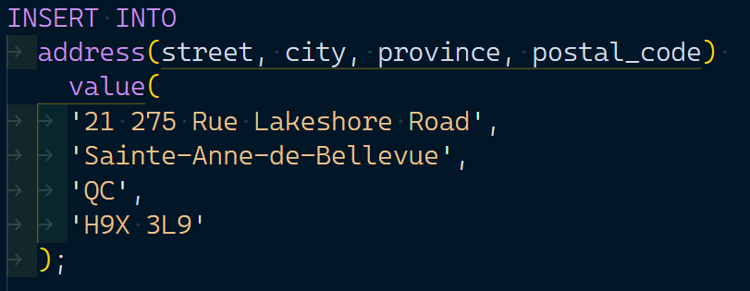
Insert Documents(Rows)
MongoDB
SQL

Slide 5
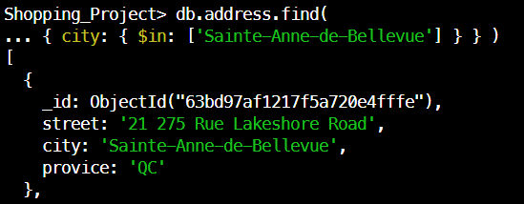
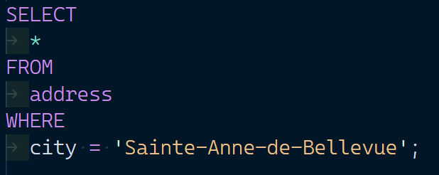
Query Documents
MongoDB
SQL

Slide 6
Update Documents
MongoDB
SQL | need to modify the table structure.

Slide 7
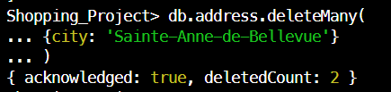
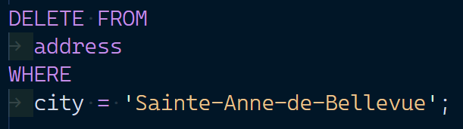
Delete Documents
MongoDB
SQL

Slide 8
Summary
MongoDB | SQL
Insert + BSON documents | CREATE TABLE INSERT INTO + VALUE
Find + Query filter documents | SELECT + WHERE
Update + Query filter documents | ALTER TABLE UPDATE + SET + WHERE
Delete + Query filter documents | DELETE + WHERE

Slide 9
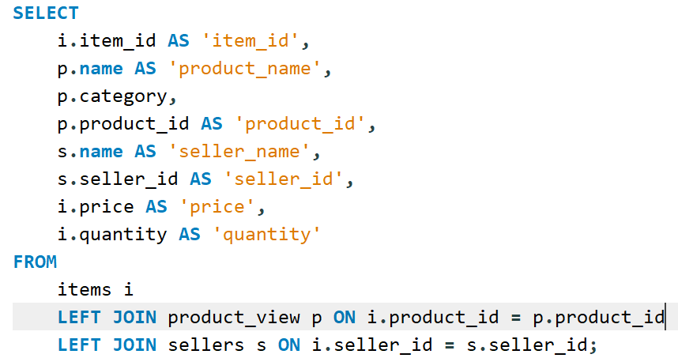
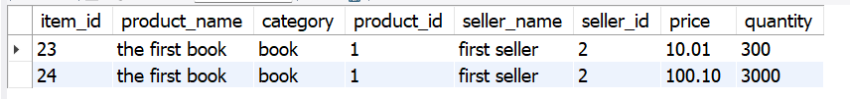
Question
how query multiple collections at once in Mongodb

Slide 10
we can use the $lookup operator in the pipeline of an aggregate function to perform a left outer join on multiple collections. Then use $unwind operator flatten outs any array, $addFields assign any data from inside of an array to the root level, $project tells which are the fields to be kept in the final output document.

Slide 11
